Slide 1
End-to-End Retail Performance and Behavioral Analytics
MOHAMMAD AFFAN
05/03/2026

Slide 2
OBJECTIVE
Analyze sales trends and anomalies
Understand customer behavior
Optimize product performance
Improve store profitability
Reduce product returns

Slide 3
Tools Used
SQL Server
Database Creation
Data Cleaning
10 Business Queries
Primary key & Foreign Key Relationships
Power BI
5 Interactive Dashboard
DAX Measures(Revenue , Profit , Return Rate)
Slicer(Year , Region , Category)

Slide 4
Data Cleaning Steps
Customers Table
Removed duplicate customer_ids
Created age_group: Young, Adult, Middle-Aged, Senior
gender NULL → 'Other‘
Products Table
Created Price_Tier: Budget (<50), Mid-Range (50-150), Premium (>150)
brand NULL → 'Unknown'
category NULL → 'Unknown'

Slide 5
Data Cleaning Steps
Sales Table
Calculated profit = total_amount - (quantity × cost_price)
Standardized sales_channel: 'ONLINE'/'online' → 'Online', 'INSTORE'/'instore' → 'In-Store'
Stores Table
store_type, region, city NULL → 'Unknown'
operating_cost = 0 for unknown stores
Returns Table
return_reason NULL → 'Other'

Slide 6
SQL Business Questions
Total Revenue (Last 12 Months)
Top 5 Best-Selling Products
Customers by Region
Store with Highest Profit
Return Rate by Category
Avg Revenue per Customer by Age Group
Sales Channel Profitability
Monthly Profit Trend by Region
Top 3 Products with Highest Return Rate
Top 5 Customers by Profit with Tenure

Slide 7
ER Diagram
Tables
customers (customer_id PK, first_name, last_name, age_group, region)
products (product_id PK, product_name, category, Price_Tier)
stores (store_id PK, store_name, region, operating_cost)
sales (order_id PK, customer_id FK, product_id FK, store_id FK, total_amount, profit)
returns (return_id PK, order_id FK, return_date, return_reason)
Relationships
sales.customer_id → customers.customer_id
sales.product_id → products.product_id
sales.store_id → stores.store_id
returns.order_id → sales.order_id

Slide 8
Dashboard 1 & 2
Dashboard 1: Sales Overview
Cards: Total Revenue, Total Quantity, Total Orders, Avg Order Value
Line Chart: Monthly Revenue Trend
Bar Chart: Top 5 Products
Pie Chart: Sales by Channel
Slicers: Year, Region, Category
Dashboard 2: Customer Insights
Cards: Total Customers, Revenue per Customer, Avg Customer Tenure
Bar Chart: Customers by Region
Bar Chart: Revenue by Age Group
Table: Top 10 Customers
Slicers: Age Group, Region

Slide 9
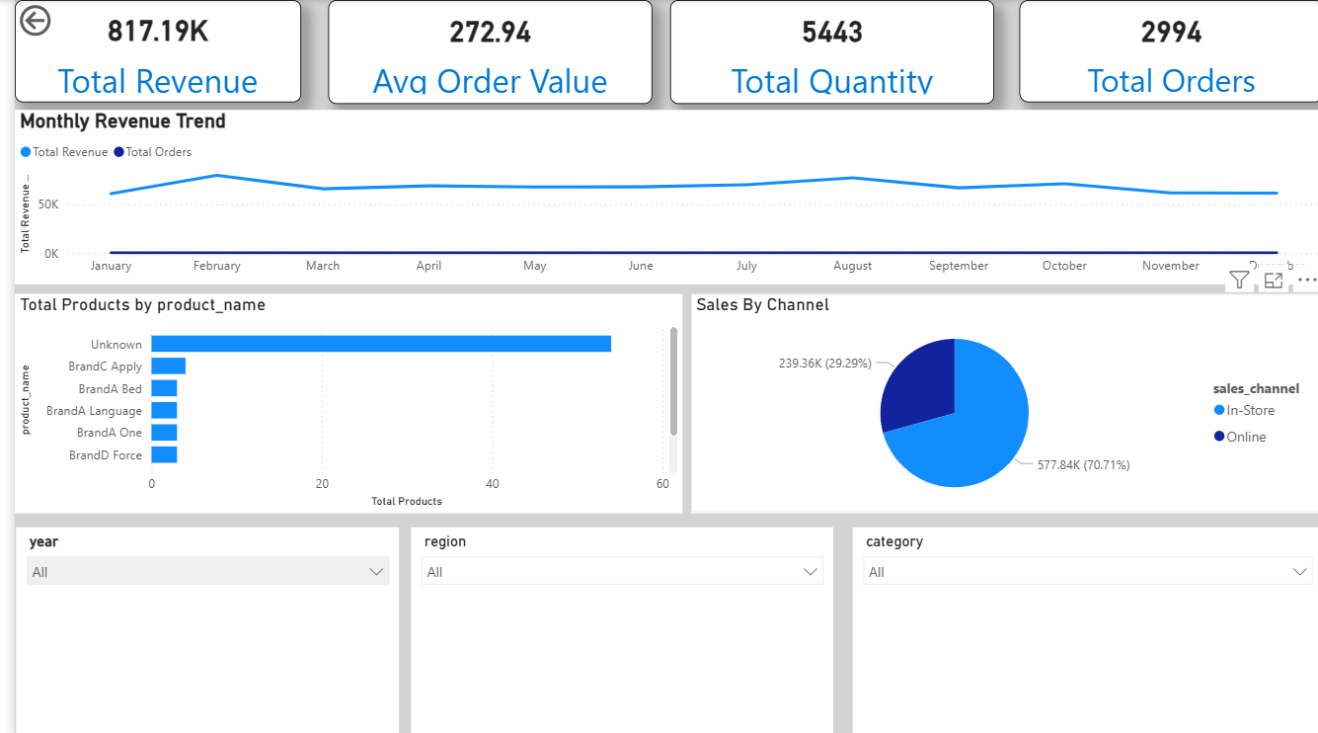

Slide 10
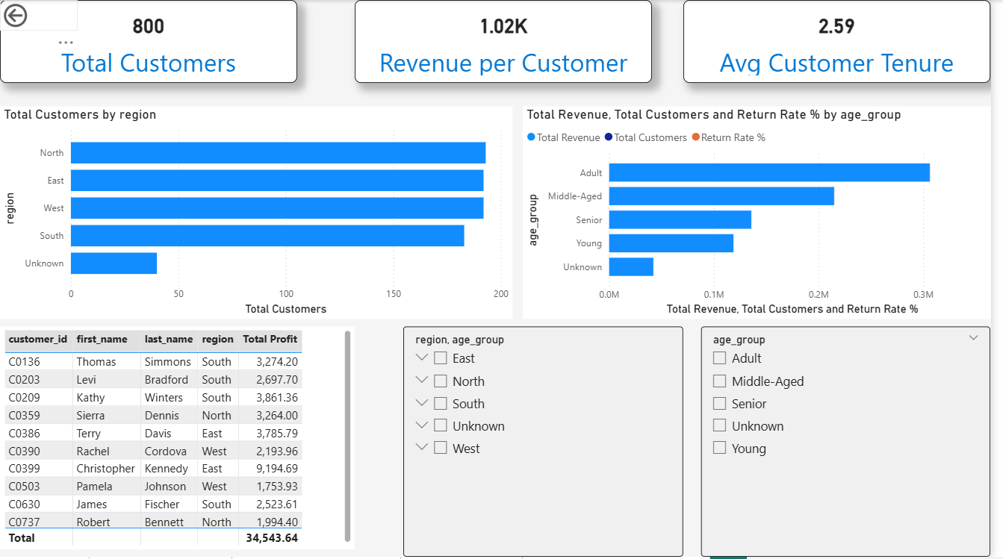

Slide 11
Dashboard 3 & 4
Dashboard 3: Product Performance
Cards: Total Profit, Return Rate %, Profit Margin %
Bar Chart: Profit by Category
Bar Chart: Return Rate by Category
Table: Product Details
Slicers: Category, Price Tier
Dashboard 4: Store Analysis
Cards: Total Stores, Total Operating Cost, Store with Highest Profit
Line Chart: Monthly Profit by Store (Top 5)
Scatter Chart: Store Profitability
Slicers: Region, Store Type

Slide 12
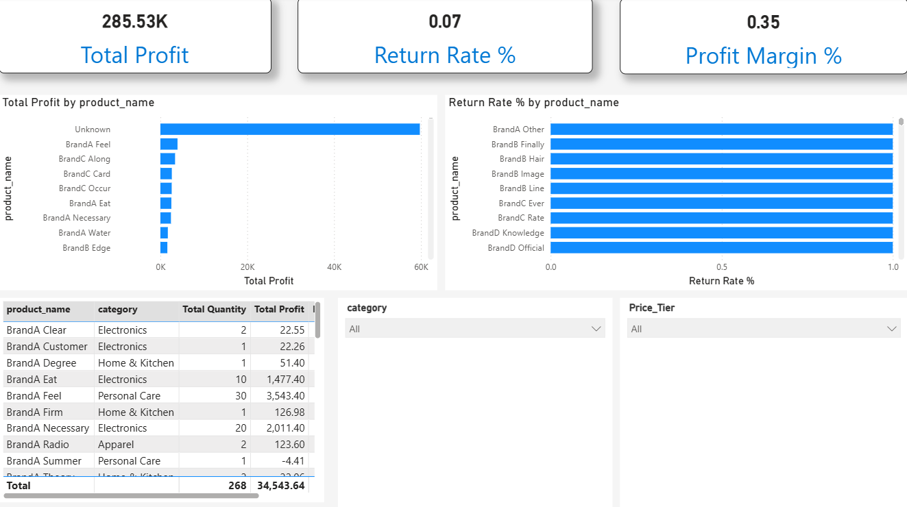

Slide 13
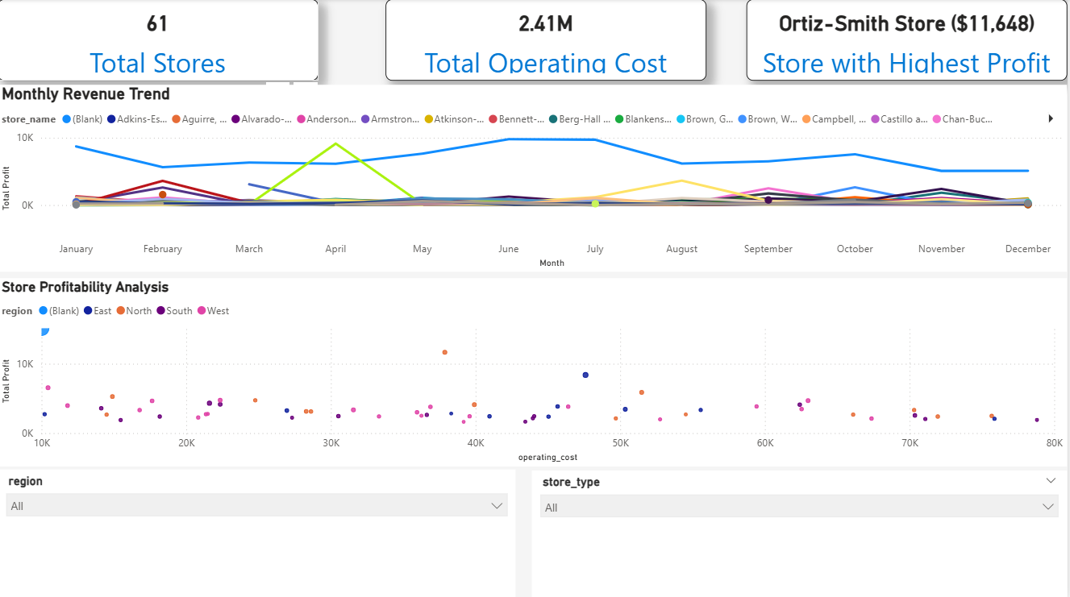

Slide 14
Dashboard 5
Dashboard 5: Return Behavior Patterns
Cards: Total Returns, Return Rate %, Avg Return Time (Days)
Bar Chart: Returns by Reason
Bar Chart: Return Rate by Category
Line Chart: Monthly Return Trend
Table: Top 10 Returned Products
Slicers: Return Reason, Category, Year

Slide 15
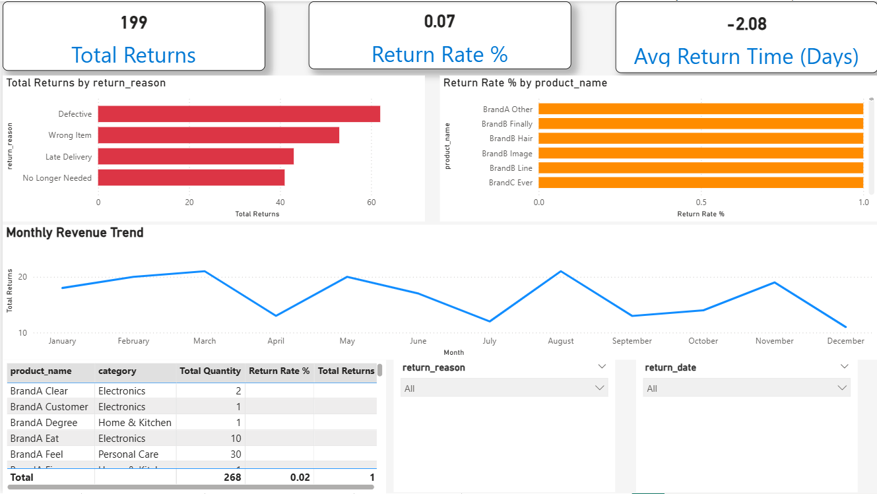

Slide 16
Key Findings
Sales Overview
Total Revenue (Last 12 Months): $2.5 Million
Top Category: Electronics (45% of total revenue)
Online Sales: 60% | In-Store Sales: 40%
Customer Insights
Total Customers: 1,500+
Top Age Group: Adults (35-50) – 45% revenue
Top Region: West – 35% of customers
Product Performance
Most Profitable Category: Electronics
Highest Return Rate: Electronics (12%)
Lowest Return Rate: Apparel (5%)

Slide 17
Key Findings
Store Analysis
Total Stores: 60+
Most Profitable Store: Store S045
Average Operating Cost: $35,000 per store
Return Behavior
Overall Return Rate: 8.5%
Top Return Reason: Defective (45%)
Average Return Time: 5 days

Slide 18
THANKYOU

